Slide 1


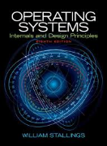
Welcome to
CS 345 Operating Systems
Operating Systems (05)

Slide 2
Operating Systems Overview
Chapter 2

Slide 3
Project 1 Signals Quiz
What is a signal?
Who can signal?
When is a signal acknowledged?
How are signals delivered to a process?
What operations are illegal within a signal handler?
How are parameters passed to a signal?
What signals might a process not handle?
How many signals might a system support?
An asynchronous notification of an event (software interrupt).
Any process / call-back / interrupt.
Pending signals processed before the process is rescheduled for execution.
Via a signal variable in the process control block.
Blocking operations (call-backs are not on the user stack).
Via global variables (not thru function parameters).
Harmless signals such as SIGSTOP.
Maximum number of bits in process signal variable.

Slide 4
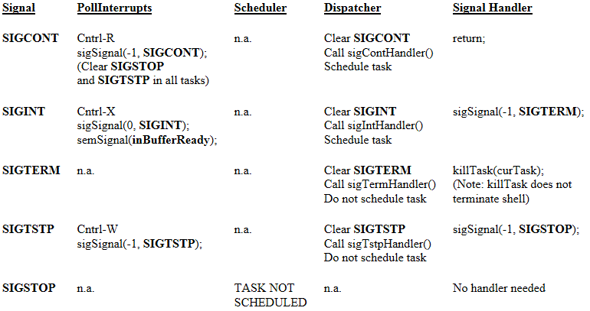
Signal Handling

Slide 5
Operating Systems Overview
Chapter 2

Slide 6
Brief Look at the Evolution of OS
In the beginning…
There were no operating systems,
No programming languages or compilers,
No mice and no windows,
and the earth was without form, and void; and darkness was upon the face of the deep.
Suppose you built a computer.
How would you get it to read and run the programs that you will write?
How would it access devices: read input and write output data?
A program runs from memory, but one must get the program into memory somehow. How would you then run a different program?
Would you have to restart the computer?
How much does the program you write have know about your system’s hardware: the details of accessing a disk or scanning a keyboard?
Can this information be hidden from application programmers?

Slide 7
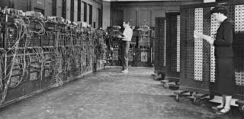
The OS Evolution
OS Complexity
ENIAC
1940
1950
1960
1970
1980
1990
2000
2010
2020
Notes:
The ENIAC (Electronic Numerical Integrator and Computer) is arguably the first general-purpose electronic computer.
Created for a very specific purpose: to compute firing tables for the military.
The machine contained: an internal memory of 200 decimal digits, I/O speed of 8,000 decimal digits per minute, computation speed of 5,000 operations per second, built with 18,000 vacuum tubes and consumed 100,000 watts (40,000 watts went to the tube filaments and were converted to heat), programmed through patch panels and switches, data read from punched cards.
“Preparing ENIAC for a series of runs was an incredibly involved process. First, detailed instructions had to be written defining the problem and a procedure for solving it. These instructions were programmed by adjusting switches manually and inserting thousands of cables into as many as forty large plug boards. A team of five operators might work several days on the external wiring and many more days searching for errors and correcting them.”

Slide 8
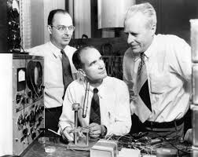
The OS Evolution
December 1947
The transistor is on the list of IEEE milestones in electronics and Bardeen, Brattain, and Shockley shared the 1956 Nobel Prize in Physics for their achievement.
OS Complexity
ENIAC
Transistor
1940
1950
1960
1970
1980
1990
2000
2010
2020
Notes:
PJ Rape

Slide 9
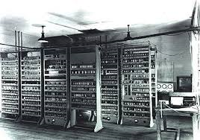
The OS Evolution
OS Complexity
ENIAC
EDSAC and EDVAC
Transistor
1940
1950
1960
1970
1980
1990
2000
2010
2020
Notes:
Cara Johnson

Slide 10
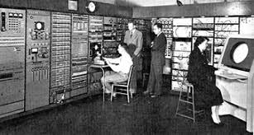
The OS Evolution
OS Complexity
ENIAC
EDSAC and EDVAC
BINAC
Transistor
1940
1950
1960
1970
1980
1990
2000
2010
2020
Notes:
John Martin

Slide 11
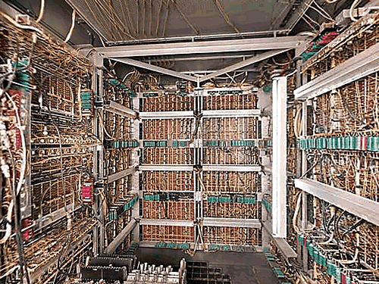
The OS Evolution
OS Complexity
BINAC
ENIAC
UNIVAC
EDSAC and EDVAC
Transistor
1940
1950
1960
1970
1980
1990
2000
2010
2020
Notes:
1951: UNIVAC by Remington - Reusable code
The concepts of code sharing emerge. A standard set of mathematical subroutines was created. These were written on paper and copied (onto the card punch) as needed. Unfortunately, programmers don’t always copy very accurately, so debugging was often needed.
John Mauchly estimated that there were perhaps twelve organizations in the world that needed and could afford a UNIVAC. Over 45 were sold.

Slide 12
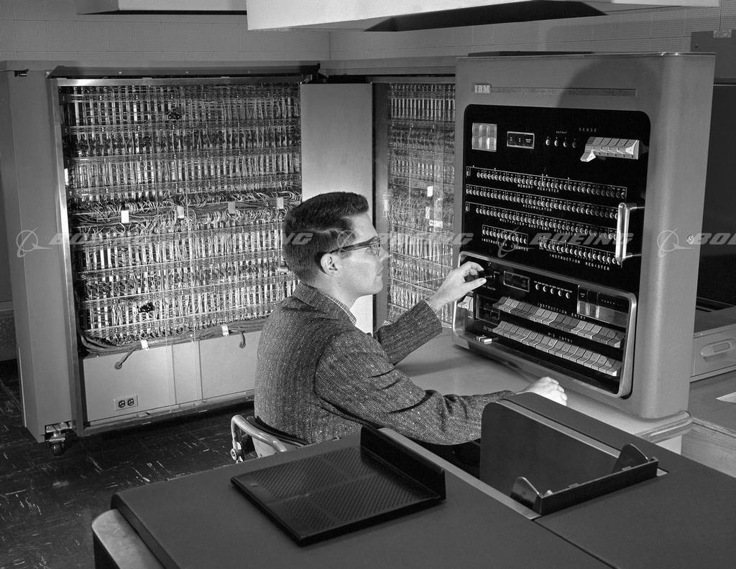
The OS Evolution
OS Complexity
BINAC
ENIAC
UNIVAC
IBM 701
EDSAC and EDVAC
Transistor
1940
1950
1960
1970
1980
1990
2000
2010
2020
Notes:
1952: IBM 701 - True reusable code and a real assembler
The 701 was IBM’s first commercial scientific computer. It contained 1,024 words of random access memory and used plastic magnetic tape as a storage medium. The computer featured a modular construction; it was built in several units that would be shipped to the customer where it would undergo final connections. This contrasts with earlier machines like the UNIVAC that had to be fully assembled at the customer site.
The 701 brought about: The emergence of an assembler-style language: IBM Speed Coding - SHARE (Society to Help Alleviate Redundant Effort), an IBM user organization, was created. It maintained a repository of common routines. For example, if you needed code for advancing the tape to a certain position and writing a block of data, you could get it from SHARE. These shared I/O routines were the precursor to device drivers found in today’s operating systems.

Slide 13
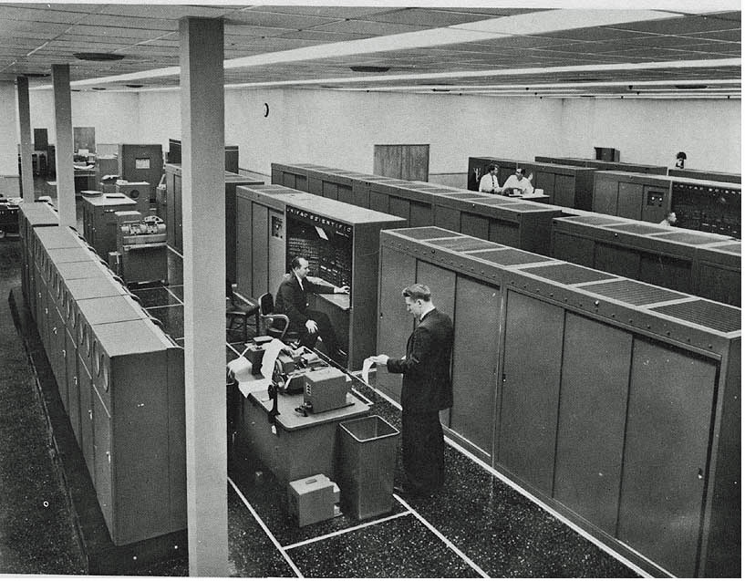
The OS Evolution
OS Complexity
BINAC
ENIAC
UNIVAC
IBM 701
UNIVAC 1103A
EDSAC and EDVAC
Transistor
1940
1950
1960
1970
1980
1990
2000
2010
2020
Notes:
Dallen Aguino

Slide 14
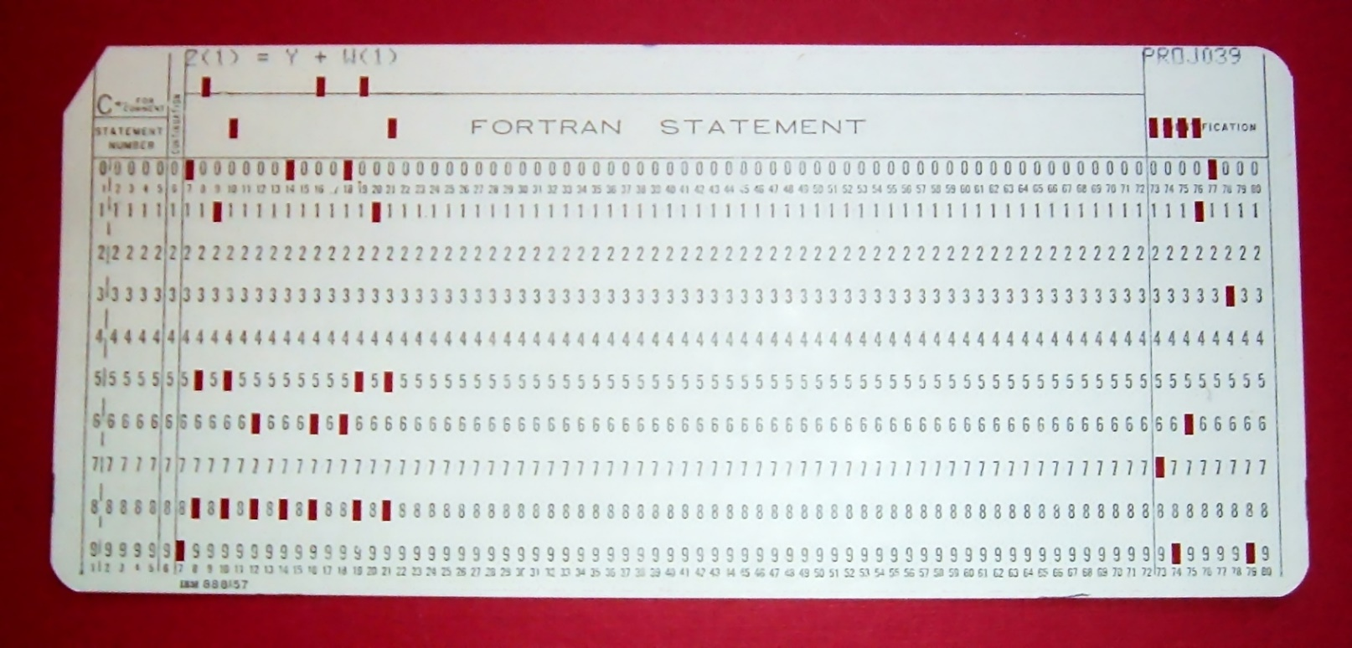
The OS Evolution
OS Complexity
BINAC
ENIAC
UNIVAC
IBM 701
UNIVAC 1103A
FORTRAN
EDSAC and EDVAC
Transistor
1940
1950
1960
1970
1980
1990
2000
2010
2020
Notes:
Connor Miller

Slide 15
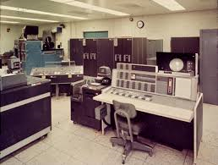
The OS Evolution
OS Complexity
BINAC
ENIAC
UNIVAC
IBM 701
UNIVAC 1103A
FORTRAN
IBM 7090
EDSAC and EDVAC
Transistor
1940
1950
1960
1970
1980
1990
2000
2010
2020
Notes:
Transaction processing systems: IBM developed the SABRE airline reservation system for American Airlines in 1960. It consisted of two connected IBM 7090 computers (built with discrete transistors) Travel agents communicated with the central computer via typewriter terminals. Although SABRE was a dedicated system and not a general purpose operating environment, it ushered in new requirements for computing.
User accounts and concurrent access required the creation of protection mechanisms and password storage.
Computers now had to operate interactively (conversationally). Because of this, human factors became an issue: response time and ease of use.
With the widespread deployment of disks, access storage organization techniques were developed followed by file systems.
Data communication links were used for remote access. For the most part, these were telephone lines

Slide 16
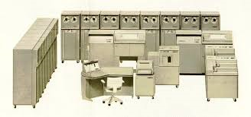
The OS Evolution
OS Complexity
BINAC
ENIAC
UNIVAC
IBM 701
UNIVAC 1103A
FORTRAN
IBM 7090
Burroughs B5000
EDSAC and EDVAC
Transistor
1940
1950
1960
1970
1980
1990
2000
2010
2020
Notes:
Virtual memory and multiprocessing
MCP was the first operating system written in a high-level language (note that this was not a portable operating system; it only ran on the B5000 computer). The B5000 system running MCP gave the user:
Multiprogramming
Multiprocessing
Virtual storage (provides the illusion of a system having more physical memory than it really does)
Source language debugging capability

Slide 17
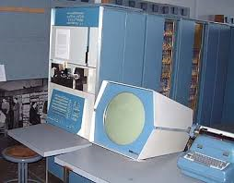
The OS Evolution
OS Complexity
BINAC
ENIAC
UNIVAC
IBM 701
UNIVAC 1103A
FORTRAN
IBM 7090
Burroughs B5000
DEC PDP-1
EDSAC and EDVAC
Transistor
1940
1950
1960
1970
1980
1990
2000
2010
2020
Notes:
Teikn Smith

Slide 18
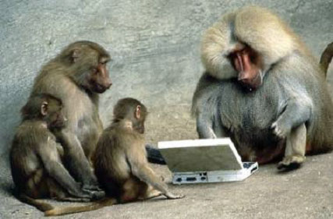

Be Safe

